Slide 1
“Aging and cancer: the importance of the host-tumor interaction”
Martine Extermann, MD, PhD
Chair, Senior Adult Oncology Program
Moffitt Cancer Center

Slide 2
Summary
Epidemiology and biology: Age matters
But one age doesn’t fit all
Ovarian cancer: the age challenge
Breast cancer
Why geriatrics matters

Slide 3
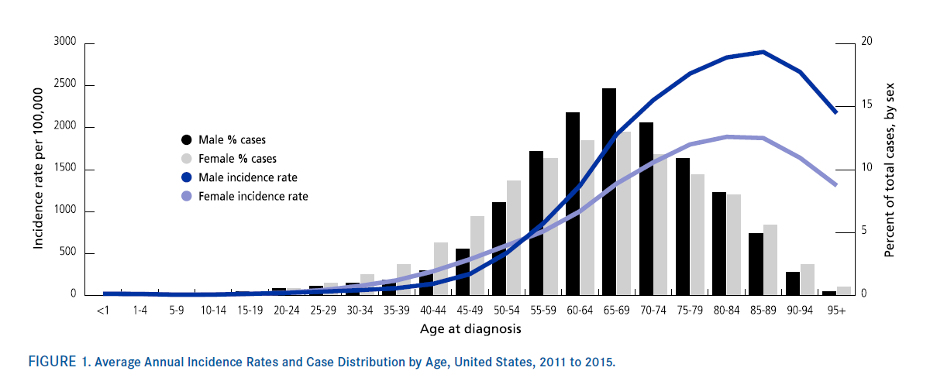
Incidence of cancer
20 yo 1/10000 per year
50 yo 1/1000 per year
80 yo 1/100 per year
Age is the strongest risk factor for cancer (even within familial syndromes)
De Santis et al., Cancer J 2019

Slide 4
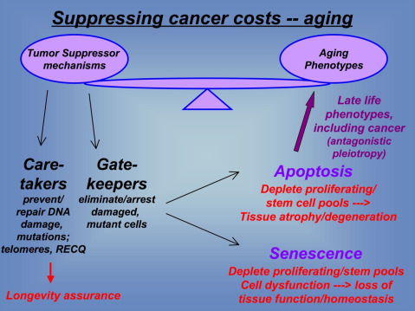
The inextricable link between cancer and aging
Judith Campisi; The Buck Institute

Slide 5
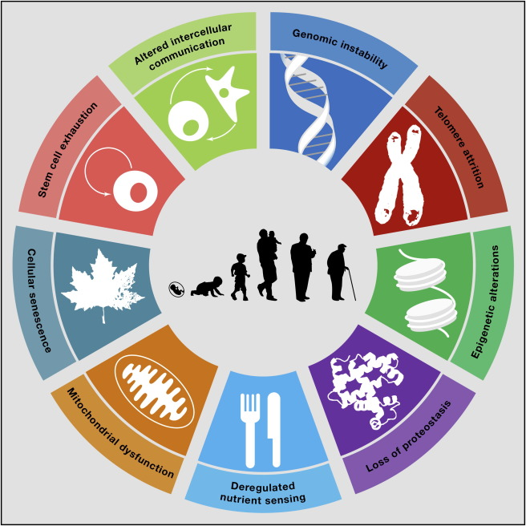
Hallmarks of Aging
Lopez-Otin et al., Cell 2013

Slide 6
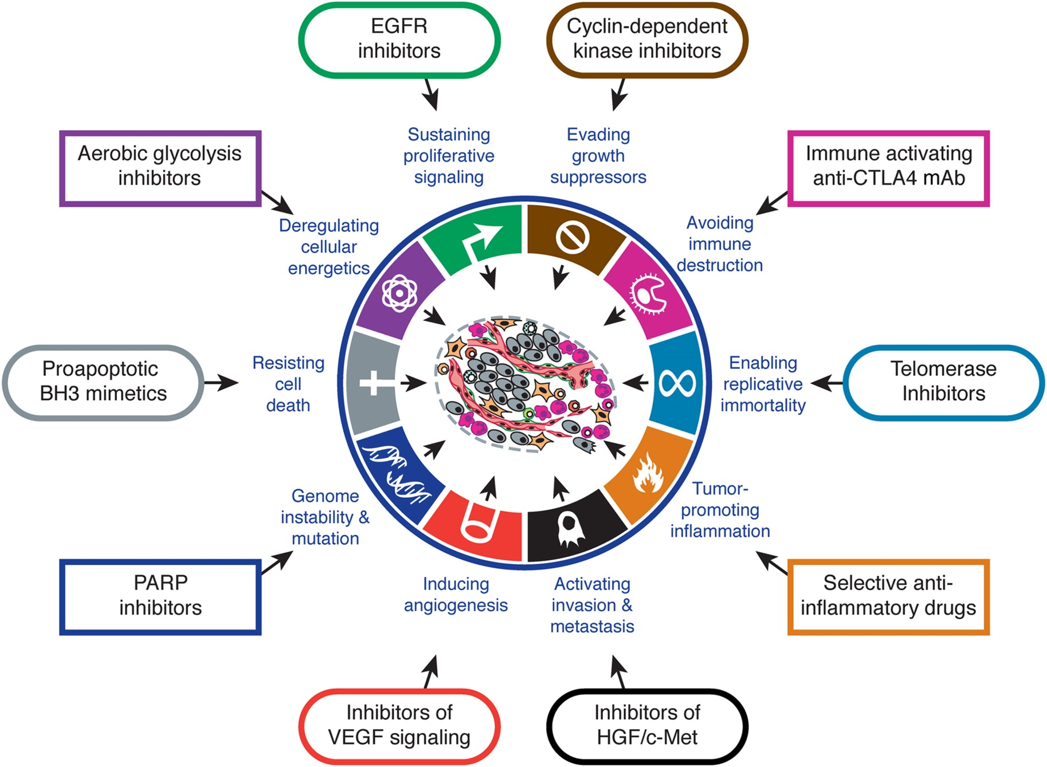
The Hallmarks of cancer
Hanahan, Cell 2011

Slide 7
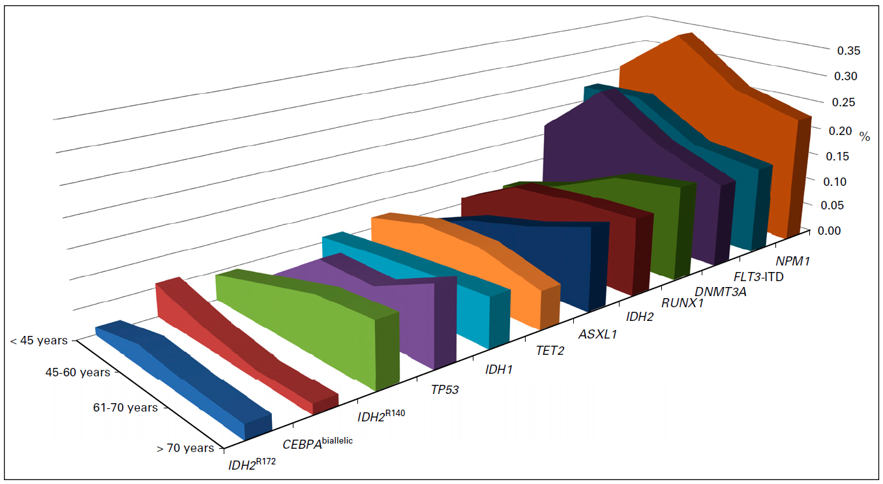
AML genomics and age
Bullinger et al. JCO 2017

Slide 8
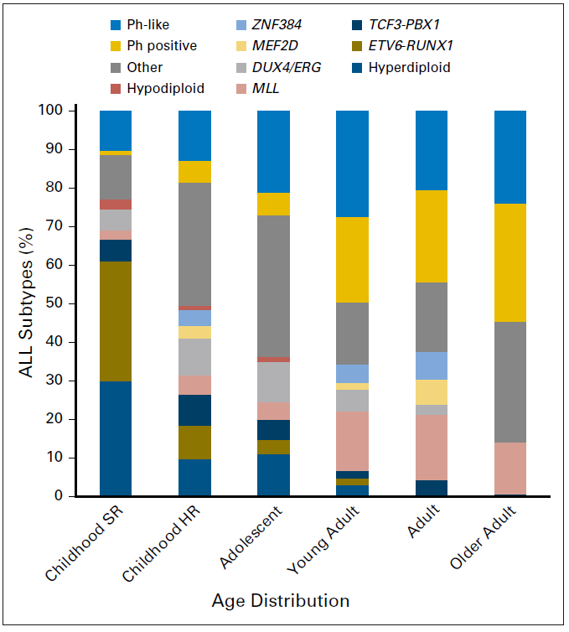
ALL genomics and age
Iacobucci & Mullighan, JCO 2017

Slide 9



One age does not fit all
Biker Bar in Florida

Slide 10
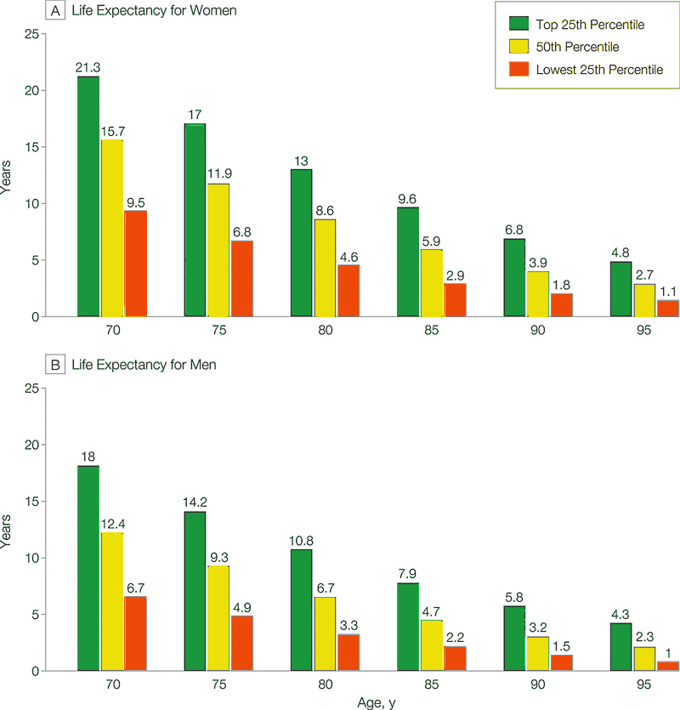
Life expectancy, USA
Walter et al., JAMA 2001

Slide 11
PCC: The full view
Tumor
Microenvironment
Macroenvironment
Notes:
11

Slide 12
microenvironment
Approach
Carcinoma cell line
10% Human Serum
30 Young
< 30 years old
30 Old
> 60 years old
Gomes et al, In Revision (Nature)

Slide 13
Serum of the old donors changes cell morphology
Carcinoma cell line
10% Human Serum
30 Young
< 30 years old
30 Old
> 60 years old
Gomes et al, In Revision (Nature)

Slide 14
Serum of old donors induces Epithelial-to-Mesenchymal Transition (EMT)
Carcinoma cell line
10% Human Serum
30 Young
< 30 years old
EMT
30 Old
> 60 years old
Gomes et al, In Revision (Nature)

Slide 15
Metastasis Process - Role of EMT
Tam and Weinberg, Nat Med 2013

Slide 16

Serum from old donors promotes metastatic colonization
MDA-MB-231
Young Serum
Y-1
Y-2
Young
MDA-MB-231
Old Serum
O-1
O-2
Old
Cells treated in culture with human serum for 5 days
Gomes et al, In Revision (Nature)

Slide 17
Serum of old donors promotes drug resistance
Gomes et al, In Revision (Nature)

Slide 18
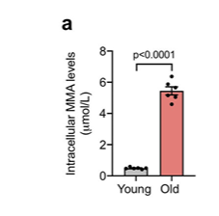
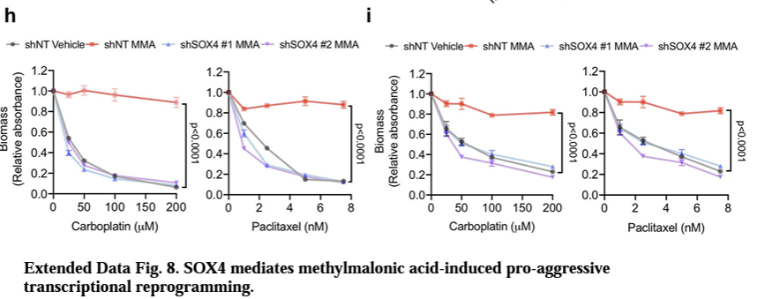
Age-related metabolic changes and cancer growth
TNBC and lung cancer cells have more metastases in older mice.
One mediator appears to be methylmalonic acid.
Age-related metabolic changes play an important role in modulating cancer growth
Gomes et al. Nature 2020

Slide 19
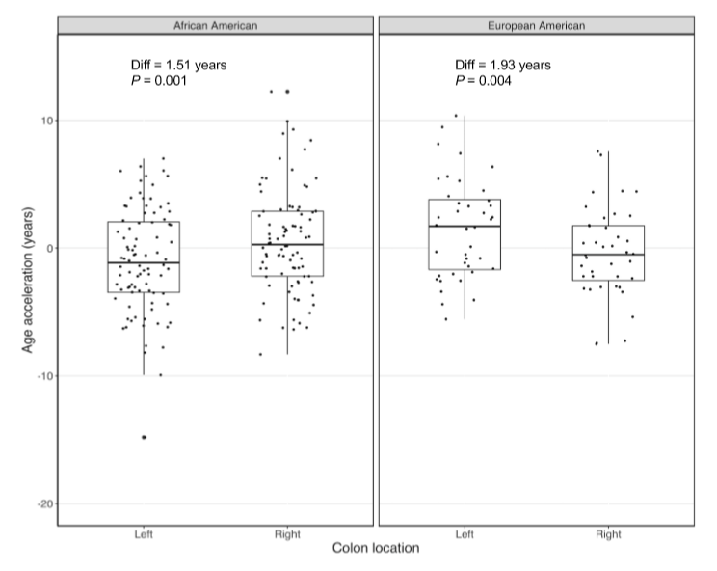
Colon epigenetic aging: AA vs EA, R vs L
Potential explanation for more right-sided CRC in AA
Devall et al. , JNCI 2021

Slide 20
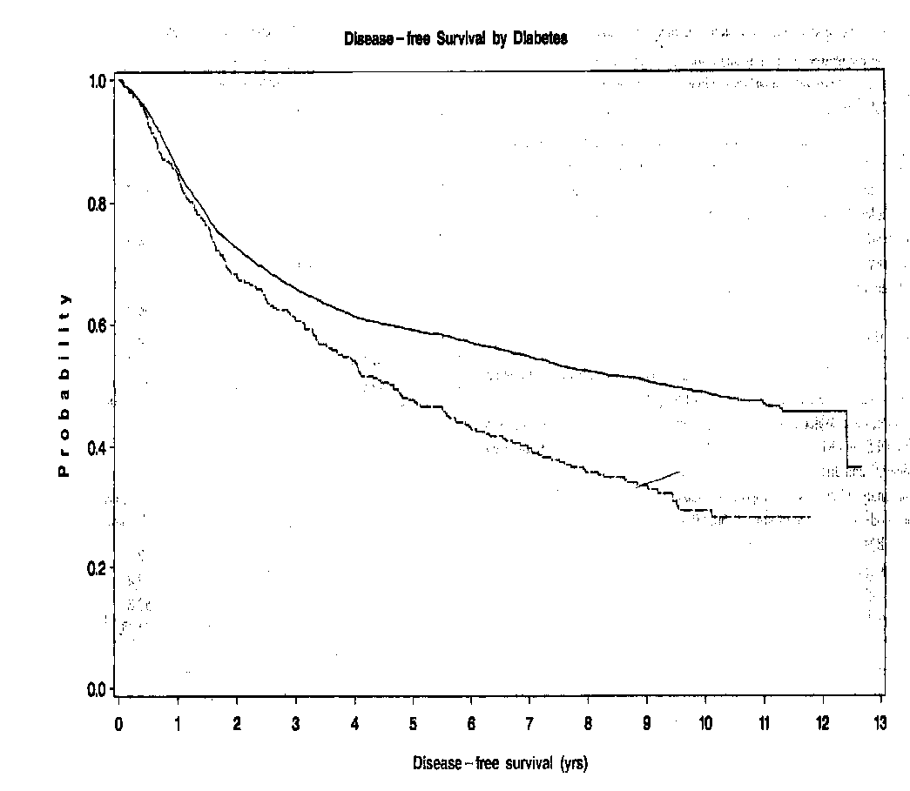
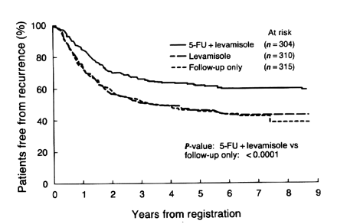
Impact of diabetes vs adjuvant chemotherapy
Diabetes Chemotherapy
Meyerhardt et al., JCO 2003
Moertel et al., Ann Intern Med, 1995

Slide 21
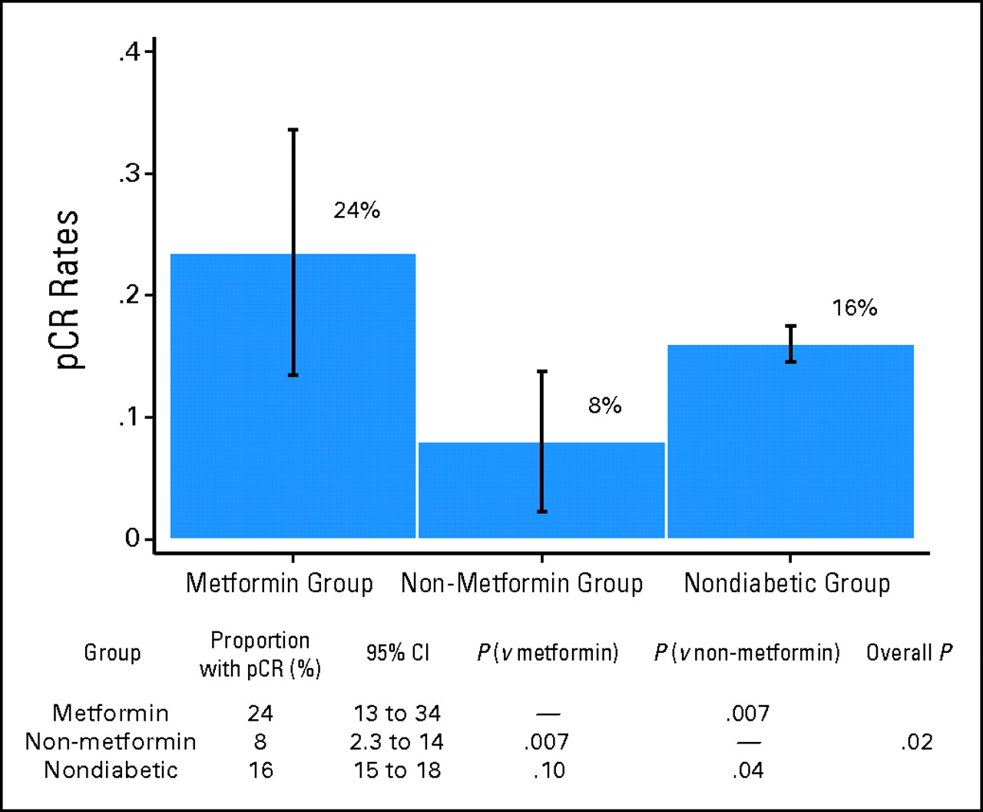
Breast cancer: pathologic CR to neoadjuvant chemotherapy
Jiralerspong, S. et al. J Clin Oncol; 27:3297-3302 2009

Slide 22
Aspirin and breast cancer prognosis
Days/week | OR BC distant relapse | OR BC deaths
0 | 1 | 1
1 | 0.91 (0.62-1.33) | 1.07 (0.70-1.63)
2-5 | 0.40 (0.24-0.65) | 0.29 (0.16-0.52)
6-7 | 0.57 (0.39-0.82) | 0.36 (0.24-0.54)
Nurses’ Health Study
4164 BC stage I-III, 341 BC deaths
Holmes et al. JCO 2010

Slide 23
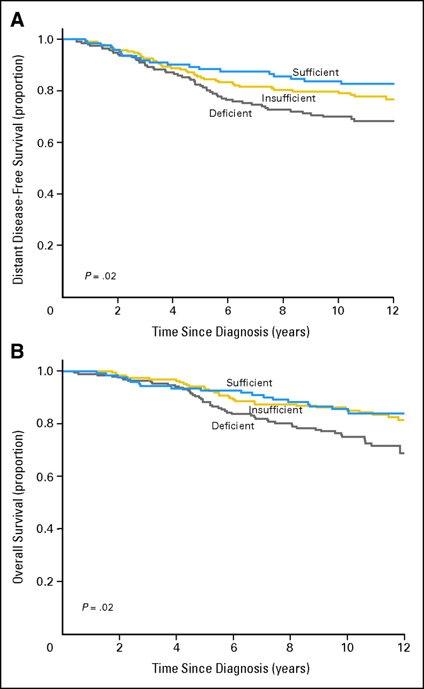
Vitamin D and BC prognosis
Early breast cancer
DFS (A) and OS (B)
Deficient: 37.5%
  25-OHD <50 nmol/l
Insufficient: 38.5%
  50-72 nmol/l
Sufficient: 24%
  >72 nmol/l
Goodwin, P. J. et al. J Clin Oncol; 27:3757-3763 2009

Slide 24
Age and ovarian cancer survival

Slide 25
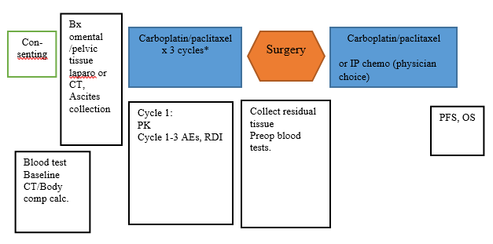
Study rationale and design
Hypotheses
A more precise dosage of CP based on body composition may contribute to improving the prognosis of OVCA in older women
A senescent micro-environment and immune system might contribute to more disease resistance and relapse in older patients.

Slide 26
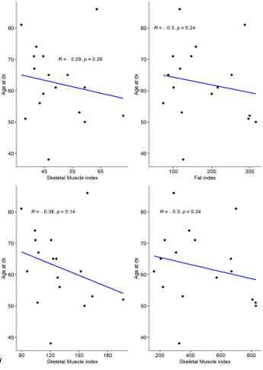
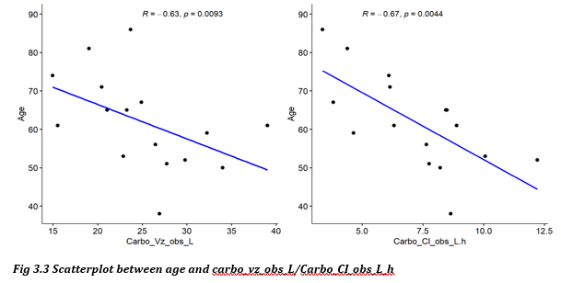
PK/body composition
No significant association with paclitaxel PK
No significant association of body composition and age
(but see plot)
Skeletal muscle index was associated with carboplatin(C) AUC (r -0.50, p < 0.05), and both total muscle (r = 0.61) and total fat (r = 0.53) were associated with C Vd. Lower SMI associated with C1G4H tox (p=0.02). C AUC p=0.15.

Slide 27
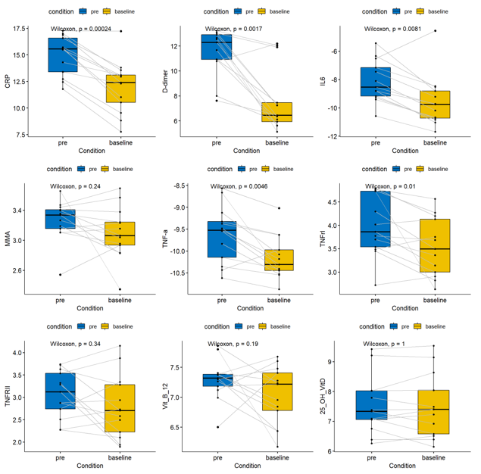
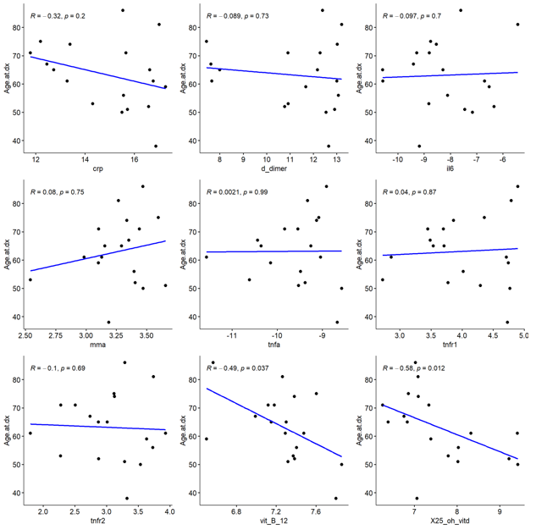
Results: biology: cytokines and metabolites
Changes in serum levels with age
Changes in serum levels pre- vs post chemo
Genomics: decrease in inflammatory pathways pre-post, increase in apoptosis pathways, no age diff.

Slide 28
Conclusions
Our patients had a high rate of delivery of preoperative chemotherapy
Interaction between body composition and PK of carboplatin
Inflammation appears to be a major player
No clear age correlation in this limited sample
Our present hypothesis: While early in the treatment, inflammation has little impact on older patients’ ability to receive chemo, its impact may be expressed later in the course of treatment (Mallen A et al., Gyn Oncol. 161(3): 693-9, 2021)

Slide 29
CHIP: Moffitt & UNC cohorts
Study Results: N = 162
By CH status:
 | OR (95% CI) | Adjusted OR* (95% CI)
Myelosuppression | 1.19 (0.60-2.35) | 1.18 (0.47-2.95)
Variables | CH + (n=62) | CH – (n=100) | P-value
Age | 77 | 75 | 0.06
Sex Female Male | 20 (32.3%) 42 (67.7%) | 57 (57.0%) 43 (43.0%) | 0.002
Race White Other | 61 (98.4%) 1 (1.6%) | 89 (89.0%) 11 (11.0%) | 0.03
Smoking (Ever) | 40 (64.5%) | 56 (56.0%) | 0.28
Metastatic | 24 (38.7%) | 24 (24.0%) | 0.046*
Treatment Hx Chemo Radiation | 12 (19.4%) 22 (35.5%) | 13 (13.0%) 14 (22.6%) | 0.28 0.001
Variables | CH + (n=62) | CH – (n=100) | P-value
Baseline Labs ANC HGB PLT WBC | 4.7 12.1 227.5 7.5 | 4.5 12.2 257.5 6.9 | 0.26 0.55 0.08 0.61
Change in CBC ANC HGB PLT WBC | -2.4 -0.9 -88.0 -3.7 | -1.8 -0.8 -77.0 -2.8 | 0.27 0.52 0.37 0.17
Heme toxicity Neutropenia Anemia Thrombocytopenia Leukopenia | 17 (27.4%) 1 (1.6%) 2 (3.2%) 14 (22.6%) | 23 (23.0%) 1 (1.0%) 1 (1.0%) 14 (14.0%) | 0.53 1.0 0.56 0.16
*Adjusted for age, metastatic disease, baseline labs, treatment history, and MAX2-heme.
*Remains significant after adjustment for age, smoking, treatment history
Gillis et al. unpublished data
Notes:
Added 31 individuals
**note: high prevalence of CH – may be due to inclusion of “probably damaging” mutations – look into

Slide 30


Slide 31

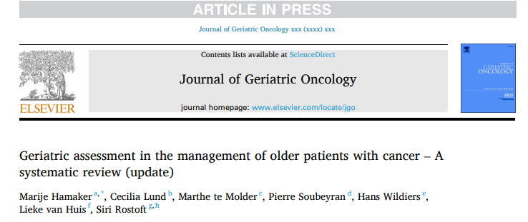

Slide 32
Update
Prior review in 2013 and 2018
New data, particularly RCTs on management
Time for an update

Slide 33
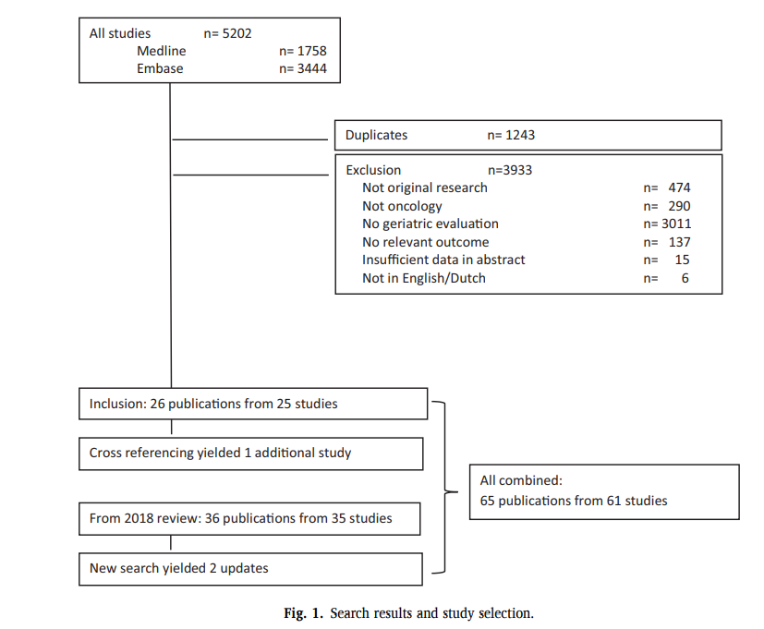

Slide 34
Study characteristics
Type of geriatric assessment
  Geriatric consultation: n=28
  Assessment by the oncology team n=17
  Assessment by a multidisciplinary (paramedical) team n=16
Study population:
  Overall 16.819 patients
  Mean sample size 123 (range 15-5631)
  Median age ranged from 68 to 83 years
  24 with a specific cancer type, the remainder with various types

Slide 35
Effect on oncologic treatment decisions
Overall: Change in median of 31% of patients (range 6–56%)
  Less intensive treatment option: 73% of changes)

Slide 36
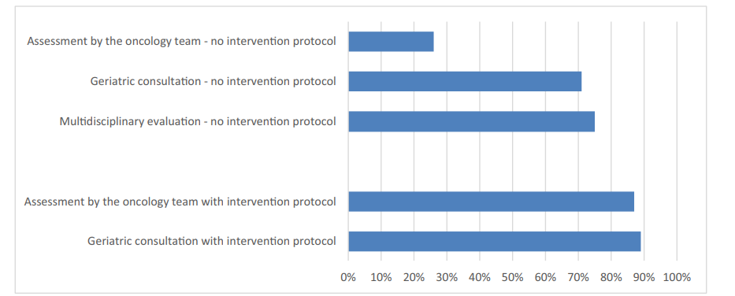
Effect on non-oncologic treatment

Slide 37
Effect on non-oncologic treatment
Oncology team assessment without a plan:
Five times less likely to have:
polypharmacy optimization
social interventions
cognitive assessment or delirium prevention measures
interventions aimed at physical function or mobility
median 72%, range 6–100%
  Polypharmacy 38% of patients
  Comorbidity optimization 30%
  Nutritional support 37%
  Social interventiosn 34%

Slide 38
Effect on communication and care planning
Three RCTs:
Advance directives: GA arm 28.4% vs. 13.3% in usual care (<0.001)
Increased odds (OR 3.12) of discussing end-of-life goals of care
Four times more ageing-related conversations
Patients and caregivers more satisfied with communication

Slide 39
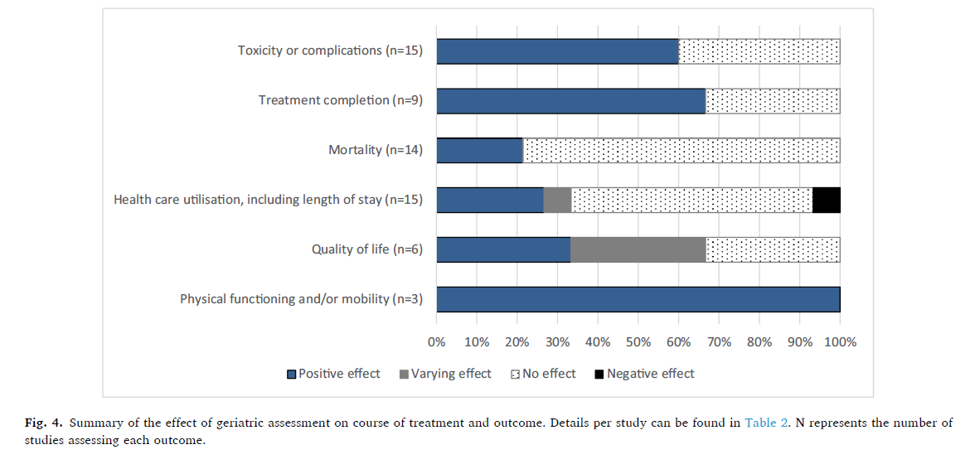
Effect on treatment outcomes
study size
GA included in decision
67%
86%
75%
100%
75% vs 33%

Slide 40
Type of evaluation
Reduction in complications/toxicity
  Multidisciplinary team evaluation 7 out of 7
  Oncology team evaluation 2 out of 4
  Geriatric consultation 0 out of 4
Treatment completion
  Multidisciplinary team evaluation 50%
  Oncology team evaluation 75%
  Geraitric consultation 67%

Slide 41
To summarize:
GA changes oncologic treatment plans, especially if done by multidisciplinary paramedical team
GA leads to non-oncologic interventions
GA improves communcation
GA can lower complications/toxicity rates, improves likelihood of treatment completion and leads to better QoL and physical functioning

Slide 42
Limitations
25 conference abstracts with limited data
Heterogeneity in methodology, study size (range 15-15631), patient population
Pooled data skewed towards methodology of larger studies

Slide 43
CGAM: systemic therapies
Study | # patients | Intervention | Toxicity | LOS/ER/Unpl. hosp | OS | Other
GAIN ASCO 2020 Abstr 12010 | 600 | Hurria screening MultiD team recommendations GNP implementation | 10% G3-5 (p=0.02) | No diff ER/Hosp/LOS | - | Adv.dir +14% (p<0.001)
INTEGRATE ASCO 2020 Abstr 12011 | 154 | Geriatrician-led CGAM integrated with care | 20% less early discontinuation (p=0.01) | 41% (-1.2 adm/pers.-year) (p<0.001) 39% ER visits 24% bed-days (-7.0/pers.-year) | - | ELFI 72 vs 58.7 @ week 18 (p=0.001)
GAP-70+ ASCO 2020 Abstr 12009 | 718 NCORP | GA summary to oncologist + recommendations for impairments | 20% G3-5 (p=0.0002) | - | NS @ 6 months | More initial dose reductions but less dose modifications
CGAM: Systemic treatment

Slide 44
CGAM: systemic therapies
Study | # patients | Intervention | Toxicity | LOS/ER/Unpl. hosp | OS | Other
Orum JGO 2020 | 363 | Geriatric evaluation +/- f-up | Tx completion 61% vs 52% (p=0.14) | No diff hosp |  | No diff in ADLs at 90 days Pop 70+, CGA+ geriatric follow-up vs CGA+ recommendations to oncologist Interesting subgroup analyses
GERICO Lund BJC 2021 | 142 (CRC) | CGA based recomendations | Tx completion 45% vs 28% (p=0.04) ↓ 11% G3-4 tox(p=0.16) | No diff hosp | No diff PFS and OS | ↑ QOL ↓ burden of illness (p=0.48) ↑ mobility (p=0.008)
Kalsi, BJC 2015 CGAM | 135 (parallel cohorts) | CGA screen ref. to geriatrician if problems. | 22% Tx as planned Trend less severe tox | - | NS @ 6 months | Pop: 70+ chemo
5C Puts, ASCO 2021, abstr 12011 | 350 | CGA + monthly calls | - | - | - | No difference in QOL, IADL CGA done on or after 1st day of treatment

Slide 45
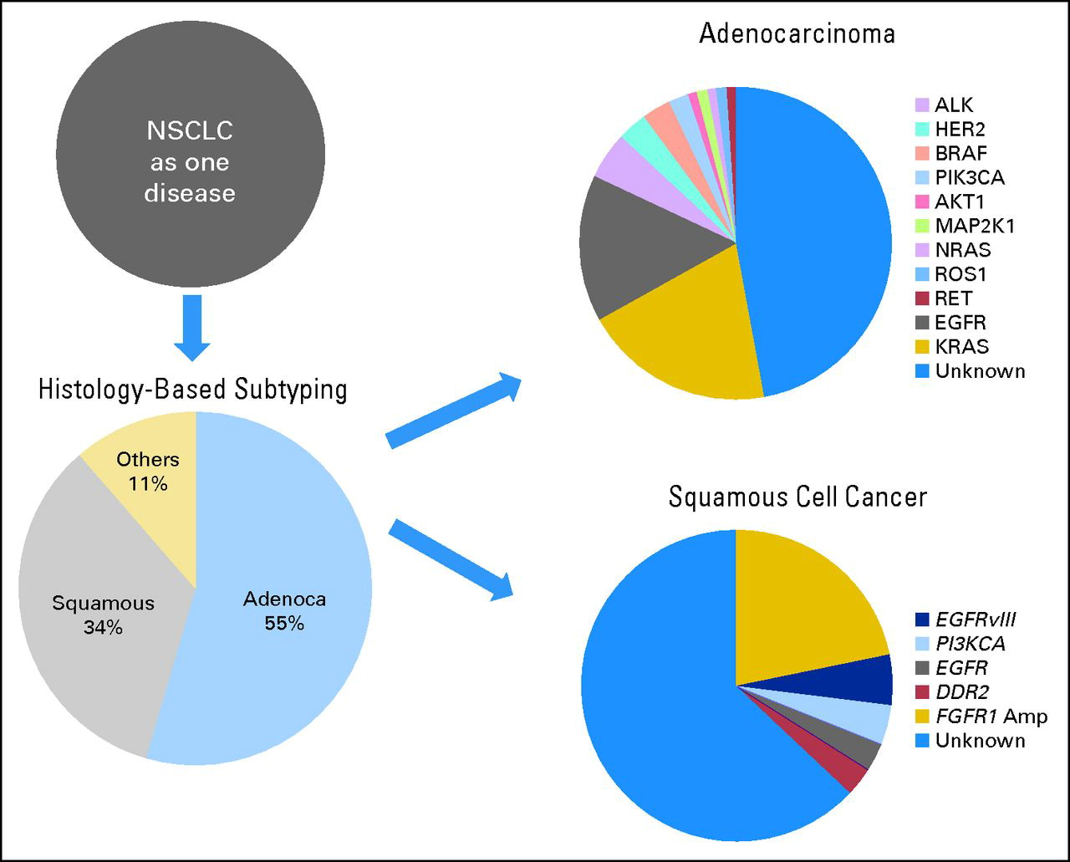
Toward Personalized Cancer Care
Too old for chemo
Li et al., JCO 2013

Slide 46
